Slide 1
Challenge 2
Tunnel Truck Detection
Made by : Mohamed Ahmed

Slide 2
Index
Description
Obstacle
Result
Ideas And Solutions
Next
One More Question

Slide 3
Description
We here want to detect the truck
Detect plate number
Segment plate number
Classify plate number
Detect truck brand
Classify truck brand
Over come the glow and haze from the video frames

Slide 4
Truck Detection
For Truck Detection we used yolo3:
uses a variant of Darknet, which originally has 53 layer network trained on Imagenet. For the task of detection, 53 more layers are stacked onto it, giving us a 106 layer fully convolutional underlying architecture for YOLO v3.
And used this pre-trained network with it’s weight that can detect many clasees like cars, cats and persons.
But question here why we used this ?
We don’t have a data set for trucks and other stuff to train with like data here.
But still can do it with R-CNN (region with convolutional neural network), Fast R-CNN, Mask R-CNN.
Even If We implement Previous Modules, Still where is the data?
We cant depend on the data we cropped from yolo3 not a way to be sure our module work fine

Slide 5
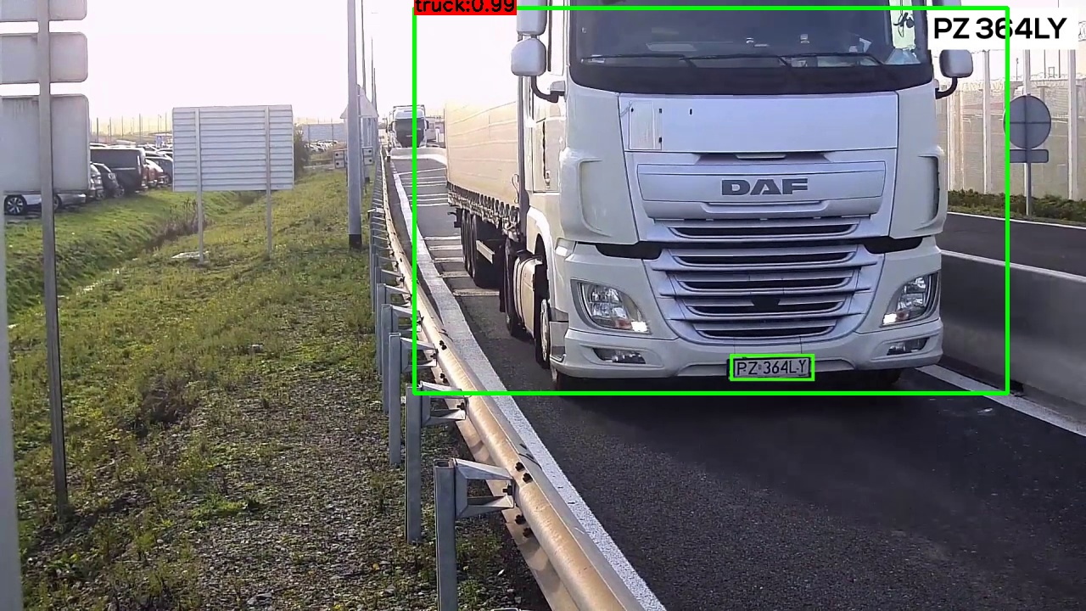
Truck Detection

Slide 6
Detect plate number
By using opencv to do
Noise removal with iterative bilateral filter(removes noise while preserving edges).
Find Edges of the grayscale image.
Find contours based on Edges.
Sort contours based on their area and in some ratio every thing else will be neglected.
loop over our contours to find the best possible approximate contour of number plate.
What are contours?
Contours can be explained simply as a curve joining all the continuous points (along the boundary), having same color or intensity. The contours are a useful tool for shape analysis and object detection and recognition.
But question here why we used this ?
We don’t have a bounded data set for plate that can use the cnn as slide window to find the plate.
Another Approach I tried to manually split the plate from cropped iamge that got it from previous model and tried it on cnn model but accuracy reach to 40%.

Slide 7
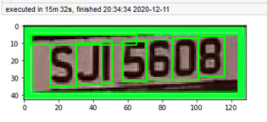
Segment plate number
Same Idea of finding the plate by contours' applied there.
This give some useless contours as noise so tried to add a ratio for it by the are of contours will not exceed the (area of plate/10) as there is 7 digits and char for plate and 1.5 on each side as space.

Slide 8
Classify plate number
By using EMNIST Dataset
Handwritten character and digits.
112799 row, 785 Pixel as training.
18799 row, 785 Pixel as testing.
Every row is character or digit (28, 28) grayscale image.
Data have 47 label from character and digits.
Did not find a data for plate segment or character from adv to work with
Next will segment every character manually

Slide 9
Classify plate number
Created A simple model from for classify character and digits using keras
Layer 1:
CNN Layer with filter=64 kernel=(5,5), Batch normalization
CNN Layer with filter=64 kernel=(5,5), Batch normalization
Max pooling Layer pool size (2,2)
Drop out for regularization
Layer 2:
CNN Layer with filter=64 kernel=(3,3), Batch normalization
Layer 3:
CNN Layer with filter=64 kernel=(5,5), Batch normalization
Max pooling Layer pool size (2,2)
Drop out for regularization.

Slide 10
Classify plate number
Layer 4:
CNN Layer with filter=64 kernel=(5,5), Batch normalization
Max pooling Layer pool size (2,2)
Drop out for regularization
Layer 5:
CNN Layer with filter=64 kernel=(5,5), Batch normalization
Max pooling Layer pool size (2,2)
Drop out for regularization
Flatten The Result and add fully connected one with 47 output cell for every character and digits in data set

Slide 11
Detect truck brand
The contour idea did not work fine here
The manual classify of images take too much time
And there was few data to depend on even my using image augmentation result never exceed 30%.
So by using opencv template match:
convert it to grayscale
resize the image according to the scale, and keep track of the ratio of the resizing
if the resized image is smaller than the template.
detect edges in the resized, grayscale image and apply template.
if we have found a new maximum correlation value.

Slide 12
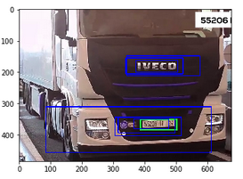
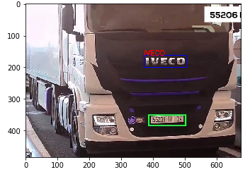
Detect truck brand
From To

Slide 13
Classify truck brand
From previous method we don’t need to use any classification.
But after detection there was some noises and miss labeling for brand.
So the manual crop of tuck brand and classify it with cnn.
Layer 1:
CNN Layer with filter=32 kernel=(3,3)
Max pooling Layer pool size (2,2)
Batch normalization
Layer 2:
CNN Layer with filter=64 kernel=(3,3)
Max pooling Layer pool size (2,2)
Batch normalization

Slide 14
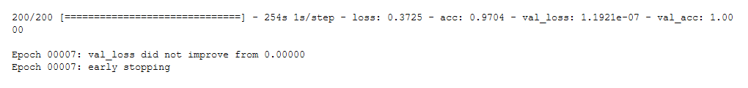
Classify truck brand
Layer 3:
CNN Layer with filter=128 kernel=(3,3)
Max pooling Layer pool size (2,2)
Batch normalization
Layer 4:
CNN Layer with filter=256 kernel=(3,3)
Max pooling Layer pool size (2,2)
Batch normalization
Flatten The result and do fully connected network
With out but of 9 brand truck.

Slide 15
Over come the glow and haze from the video frames
where I is the observed intensity, J is the scene radiance, A is the global atmospheric light, and t is the medium transmission. Intuitively, the haze image is a linear combination of the scene radiance and scattered atmospheric light. If we can recover A and t from the hazed image, then we can use this model to solve for J, the unhazed image.
Full Description on word file attached

Slide 16
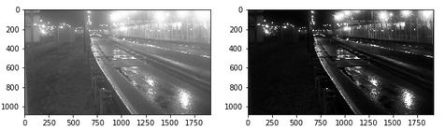
Dehazing

Slide 17
Obstacle
The Shortage of Plates Dataset mean by that the bounded of plate to create model for detection.
The Shorage of character and digits data set for not like Eminst the hand written one no, a real plate segmented or some thing similar not gray scaled on.
Shortage of dataset of truck brand only even for the whole truck or just the brand.
The hazed image even after enchantment the sharping of colors make, some color be same the like brown close to black and this delete useful information.
Frame for every video was so big to just print one result may take 2 to 5 min

Slide 18
Ideas And Solutions
For data set shortage we need more videos and cropping it with yolo making a good data set s then we can define our Truck brand.
Manual or automation bounding of plates and brand just to be sure that our module work fine and giving good results
The de haze omega will be related more to the day light that can be adaptive from it not just constant value.

Slide 19
Next
Still need some time:
improving dehazing method.
Cropped data from truck and plate will be used to save bounded plate on image and train it to not good idea because not all brand would be catched.
Every module is created spartanly and this cause some issues in integrated like type and format of input and output
The time for each frame to be process is too long and there for the resize function was created but it cause the plate segments became so small to get it, so we need to do it in the full frame and more process

Slide 20
One More Question
HOW CAN WE REACH TO 99.90% Accuracy Even Human eye can’t reach from the hazed viedo?

